Slide 1
Enterprise Resource Planning(ERP)

Slide 2
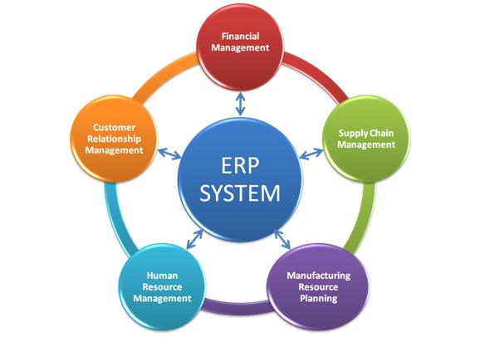
What is ERP?
The Full form of ERP is Enterprise Resource Planning.
ERP is a business management software.
It is a suite of integrated application that helps users to store and manage data of their business.
One of the most important activities associated with the implementation of an ERP system is the opportunity to streamline and improve the business operations of an organization through business process re-engineering and the by implementing the best practices and standards.
ERP software is very useful for large organization. It comes in many modules:
Human Resources
Financial Accounting
Supply Chain Management
Customer Relationship Management
Inventory
Purchasing
Project management

Slide 3
Why implement an ERP System?
An ERP is the best option for demonstrating value by providing real-time information to all employees of a corporation across departments.
1. Integrate Financial Information
Enterprise owners want to understand company's overall performance because in numerous situation they may find various versions of the truth. Finance and sales have another version and business units may have their version of the contribution of revenues for the organization. By implementing ERP, they can get a single version of the truth.
2. Standardize and Speed up Manufacturing Processes:
ERP systems come with methods for automating manufacturing process. This helps organizations to speed up and standardize the manufacturing process.
3. Reduce Inventory:
It helps to increase the visibility of the order fulfillment process of any company. It may lead to reduced inventories to make products.
4. Increases and Improves Interaction:
ERP system also helps to increase and improve interaction between customers and suppliers. Moreover, the suppliers can also communicate more seamlessly with sales, marketing, and finance team.

Slide 4
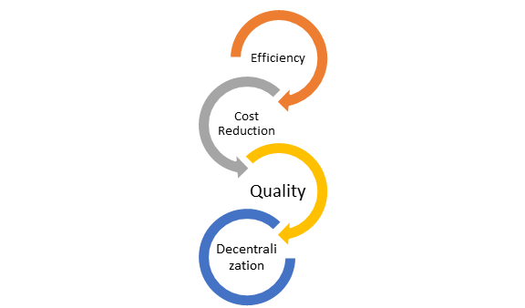
What are Primary Goals for the ERP System?
The goal of any ERP project is to track supply chain actions from inventory purchase, processing, and final shipment.
1. Efficiency
The real-time information flow in ERP system eases the analysis, data, and reporting. It also improves decision-making. It also helps to reduce the need for maintaining multiple databases.

Slide 5
2. Cost Reduction
Cost reduction is vital reason why small and large enterprises invest huge time and resources for implementing ERP systems. It will reduce waste and increase productivity. It also reduces overall production's cost.
3. Quality
Quality improvement is the most important goal of ERP. The software technology helps management to benchmark its quality performance against other manufacturing companies in the same industry.
4. Decentralization
Enterprise resource planning systems can decentralize decision-making process at all level. It also allows users to have real-time access to the same data, such as production status and financial reports.

Slide 6
Benefit of ERP System:
An ERP system is easily scalable so adding new functionality according to the business plan is very easy.
By offering accurate and real-time information ERP software reduces administrative and operations costs.
ERP system improves data quality by improving the underlying processes which help organizations to make better business decisions.
ERP system helps to improve data access with the use of advanced user management and access control.
ERP provides transparency to the organization
Helps to eliminate redundancy in the data management system
Offers a higher level of security by allowing restricting employee's accounts only to the processes.
It helps to helps make reporting easier and more customizable.

Slide 7
Drawback of ERP System:
The up-front cost of the entire implementation can be very high for any small-to-medium-sized businesses.
ERP deployments take a relatively longer amount of time. Sometime it may take 1-3 years to be implemented and be fully functional.
Migration of existing data is very difficult to achieve. That' why Integrating ERP systems with other standalone software systems is equally difficult.
ERP implementations are very difficult in decentralized organizations with different kind of business processes and systems.

